Slide 1


by Jovanovići

Slide 2
Team project
Tank Warfare, battle between two tanks with powerups and upgrades
If you like tank games, top-down and arena shooters you will like this too
Can be found here:
github.com/UbiBelETF/dagger/tree/team/jovanovici/main
Notes:
You should have a working knowledge
of basic object-oriented programming concepts and at least some experience
programming in C++.

Slide 3
Team members
Uros Jovanović
Svetozar Jovanović
Aleksa Jovanović
Notes:
You should have a working knowledge
of basic object-oriented programming concepts and at least some experience
programming in C++.

Slide 4
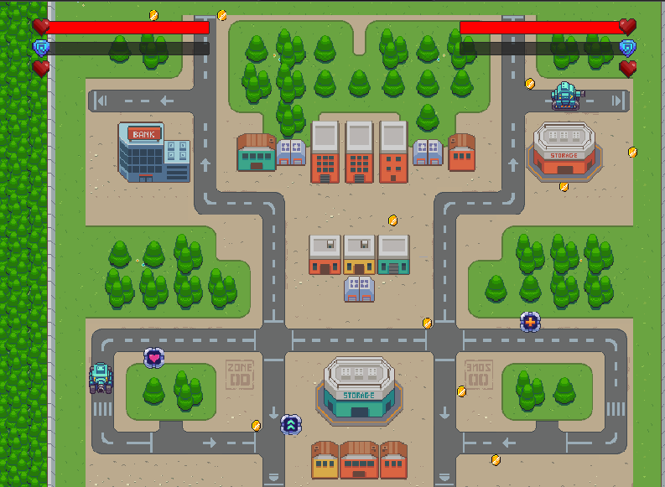
Look OF the game
The map is big, filled with trees and buildings.
They are a good way to hide and evade enemy attacks.
There are also powerups and coins that can be collected.
There are four types of powerups, extra life, health, shield and fire rate up.
Coins can be collected to upgrade your tank.

Slide 5
MAIN mechanic
The players can move around the map, collect powerups and coins and fire in order to defeat the other tank
Notes:
You should have a working knowledge
of basic object-oriented programming concepts and at least some experience
programming in C++.

Slide 6
Setting description
This is the world of warfare between two tanks that fight in the middle of a small town
They are the only survivors of the fighting forces, so whoever wins this battle wins the war
Notes:
You should have a working knowledge
of basic object-oriented programming concepts and at least some experience
programming in C++.

Slide 7
ENDGAME
Your goal is to defeat the enemy tank
The game is finished when your opponent runs out of lives and health
Notes:
You should have a working knowledge
of basic object-oriented programming concepts and at least some experience
programming in C++.

Slide 8
Obstacles
Winning in this battle is hard because there are powerups and one upgrade that gives the opponent huge advantage.
Notes:
You should have a working knowledge
of basic object-oriented programming concepts and at least some experience
programming in C++.

Slide 9
Game features
Controls:
One tank is moving on AWSD, fires on space and is upgraded on left shift
The other one is moving on arrow keys, fires on right ctrl
and is upgraded on right shift
Game menu navigation is using the mouse or space key.
Implemented by the whole team
Notes:
You should have a working knowledge
of basic object-oriented programming concepts and at least some experience
programming in C++.

Slide 10
Game features
Camera system:
This system follow locations of both tanks
and keeps them in cameras range.
It zooms in and out as needed.
Implemented by Aleksa
Notes:
You should have a working knowledge
of basic object-oriented programming concepts and at least some experience
programming in C++.

Slide 11
Game features
Custom collisions:
Objects react differently to collisions with different objects
Implemented by the whole team
Notes:
You should have a working knowledge
of basic object-oriented programming concepts and at least some experience
programming in C++.

Slide 12
Game features
Collectible system:
Coins and power ups spawn randomly on the map
Power ups have different effects on the tanks
based on the power up type
Coins are used to upgrade the tank
Implemented by Aleksa
Notes:
You should have a working knowledge
of basic object-oriented programming concepts and at least some experience
programming in C++.

Slide 13
Game features
Demo level:
game take place in small town filled with trees and buildings which makes it a good battleground
It is implemented using tilemaps
Implemented by Uros, Svetozar
Notes:
You should have a working knowledge
of basic object-oriented programming concepts and at least some experience
programming in C++.

Slide 14
Game features
End mechanics:
game is finished when one of the players runs out of lives and health
Implemented by Aleksa
Notes:
You should have a working knowledge
of basic object-oriented programming concepts and at least some experience
programming in C++.

Slide 15
Aleksa Jovanović
Dagger practice
Ping pong feature
Controller system
Camera system
Collision system
Rocket system / Collectibles system
Start screen / Player stats
Camera system fix /
Upgrade system /
Final polishing
Uros Jovanović
Dagger practice
Ping pong feature
Controller system
Collision system
Collision system
Map Tile System
Camera system fix / Final polishing
Svetozar Jovanović
Dagger practice
Ping pong feature
Controller system
Collision system
Map Tile System
Map Tile System
Bug fixes /
Final polishing
Notes:
You should have a working knowledge
of basic object-oriented programming concepts and at least some experience
programming in C++.

Slide 16
Postmortem
What went well?
Teamwork. We really understand and help each other as if we’ve been working for years together
Making all the system went without any hiccups and problems
Notes:
You should have a working knowledge
of basic object-oriented programming concepts and at least some experience
programming in C++.

Slide 17
Postmortem
Things we were planning to add
True multiplayer
a circle around the map that shrinks every few seconds and the players need to stay in that circle otherwise their health would decrease
Notes:
You should have a working knowledge
of basic object-oriented programming concepts and at least some experience
programming in C++.

Slide 18
Postmortem
What went wrong?
if we had had a little more time we would have finished everything
Notes:
You should have a working knowledge
of basic object-oriented programming concepts and at least some experience
programming in C++.

Slide 19
Postmortem
If we could start over, what would we do differently?
Put more time in this project and organize a bit better
Notes:
You should have a working knowledge
of basic object-oriented programming concepts and at least some experience
programming in C++.

Slide 20
Postmortem
the biggest things we've learned from this experience:
Git
ECS Framework
Game making process
Teamwork
Notes:
You should have a working knowledge
of basic object-oriented programming concepts and at least some experience
programming in C++.

Slide 21
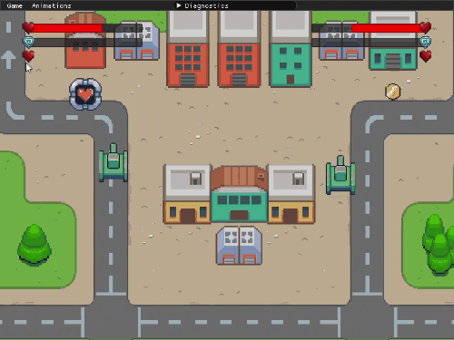
Gameplay gifs
Notes:
You should have a working knowledge
of basic object-oriented programming concepts and at least some experience
programming in C++.

Slide 22
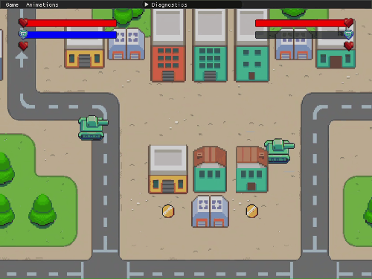
Gameplay gifs
Notes:
You should have a working knowledge
of basic object-oriented programming concepts and at least some experience
programming in C++.

Slide 23
We want to share...
This was really good and fun experience, and a place where we learned a lot about teamwork, organization and game development.
Notes:
You should have a working knowledge
of basic object-oriented programming concepts and at least some experience
programming in C++.

Slide 24
Thank you!
Notes:
You should have a working knowledge
of basic object-oriented programming concepts and at least some experience
programming in C++.

Slide 25
Questions
Notes:
You should have a working knowledge
of basic object-oriented programming concepts and at least some experience
programming in C++.

